Slide 1
Segmentation of Organs
Team Members:
1.Hari Krishna [1901044]
2.Indra Kumar [1901054]
3.Jerry Alan [1901059]
Guide:
DR.R.ANURADHA,ASSO.PROF/CSE

Slide 2
Agenda:
Introduction
Abstract
Existing and it's drawback
Proposed and it's advantages
Literature survey
Problem description(ur work)
Module description
Requirement specification
Screenshots
Conclusion and future enhancement
References

Slide 3
Introduction:
Segmentation is the key process of identification of ROI of a disease region to assist in the diagnosis of diseases. It is very important in medical imaging where localization is paramount to the analysis of scans.
Segmentation classifies each pixel to the part of the image the pixel belongs to and it produces the output for each pixel.
Recent advancement in machine learning methodologies has led to the development of deep learning techniques in the field of medical images analysis for the diagnosis of various diseases

Slide 4
Abstract
This project concentrates on medical image segmentation using deep learning and image processing techniques which helps doctors or clinicians to diagnose certain types of abnormal things in a particular organ.
The primary focus is on segmenting brain tumors into these three categories (glioma tumor, meningioma tumor, pituitary tumor), secondly Lung segmentation using chest radiographic images to diagnose pulmonary vascular problems, finally retina blood vessel segmentation to diagnose diabetic retinopathy, cardiovascular and ophthalmologic diseases.

Slide 5
Existing System
There are several image segmentation tools like 3Dslice, ITK-Snap and many more which are all require manual intervention in order to find or segment some abnormality from the radiographic images. In traditional method a clinician should require computational tools to find some abnormality in the images this slows down the process of treatment for the doctors as some doctors needs to see the images and start the treatment accordingly

Slide 6
Proposed System
The proposed project uses U-Net as base model and Resnet34 is used as backbone of it to segment the images and produce respective results with high accuracy. The intuition behind U-Net is to encode the image passing it through a CNN as it gets downsampled and then decode it back or upsample it to obtain the segmentation mask. The features to be detected in the mask depends on the learned weight filters, upsampling & downsampling blocks (which can also be made learnable) and the concatenations & skip connections. The backbone is the architectural element which defines how these layers are arranged in the encoder network and they determine how the decoder network should be built. The backbone used is ResNet34 which performs encoding and downsampling by itself.

Slide 7
Literature Survey:
U-Net and its variants for medical image segmentation: This paper states about how U-Net as been applied in medical industry. U-Net is an image segmentation technique developed primarily for medical image analysis that can precisely segment images using a scarce amount of training data. These traits provide U-Net with a very high utility within the medical imaging community and have resulted in extensive adoption of U-Net as the primary tool for segmentation tasks in medical imaging.

Slide 8
Literature Survey:
Residual Attention U-Net for Automated Multi-Class Segmentation of COVID-19 Chest CT Images:
This paper states that novel deep learning model has been used for rapid and accurate segmentation of COVID-19 infection regions in chest CT scans. The model which is developed is based on the U-Net architecture, inspired with recent advancement in the deep learning ﬁeld.

Slide 9
Problem Definition:
Medical image segmentation has an essential role in computer-aided diagnosis systems in different applications. It divides an image into areas based on a specified description, such as segmenting body organs/tissues in the medical applications for border detection, tumor detection/segmentation, and mass detection.

Slide 10
Modules:
Module 1:
DataSet collection for multiple organs and diseases and preprocessing of dataset
Module 2:
Model Building and fine tuning
Module 3:
Model Deployment(Web application) and Visualization

Slide 11
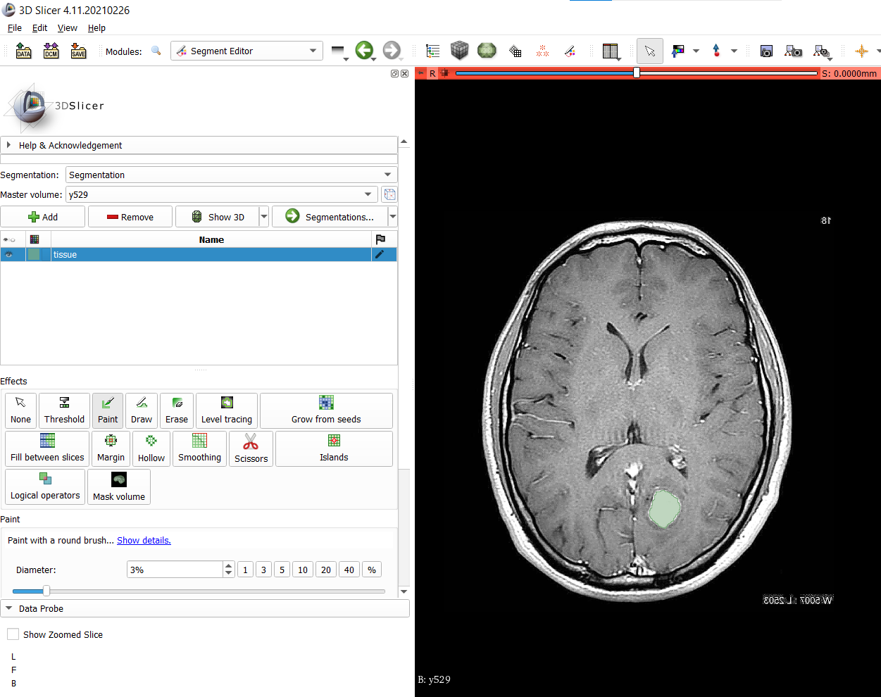
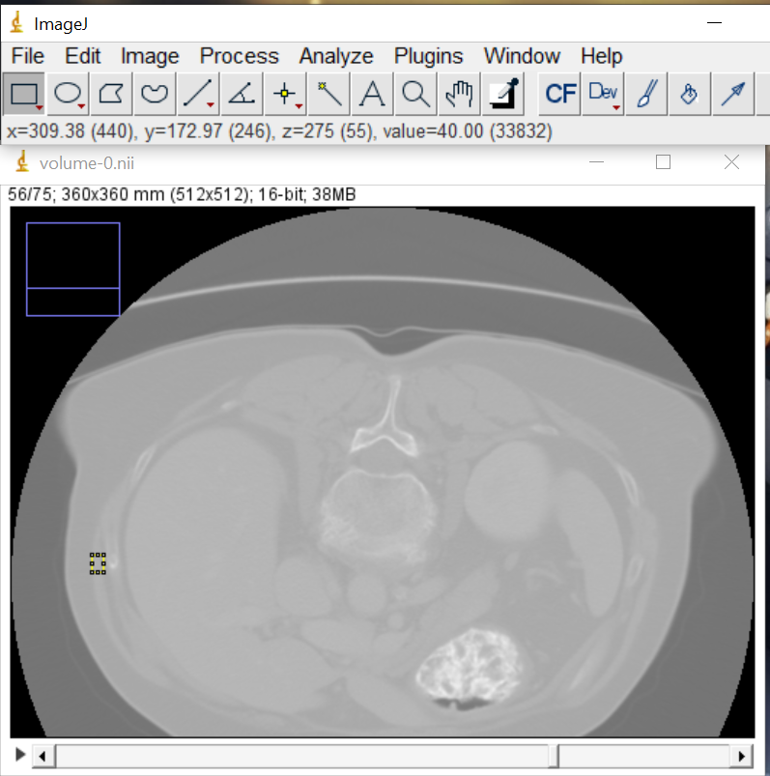
Hardware and Software Requirements:
Software Requirements:
ITK Snap
3D Slicer
Imagej
Hardware Requirements:
Laptop or Desktop with GPU

Slide 12
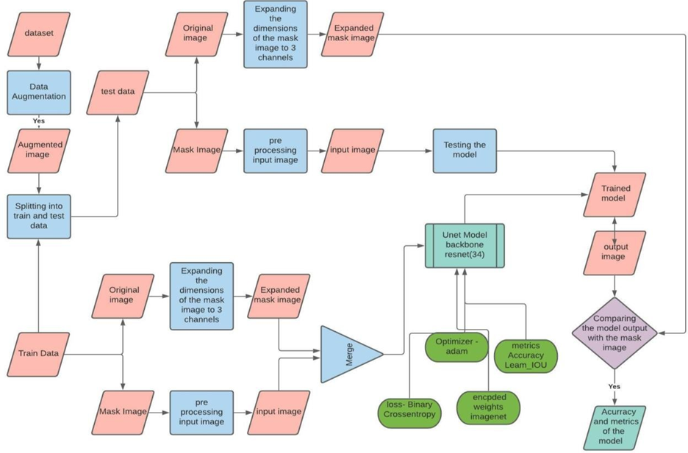
Model Pipeline

Slide 13
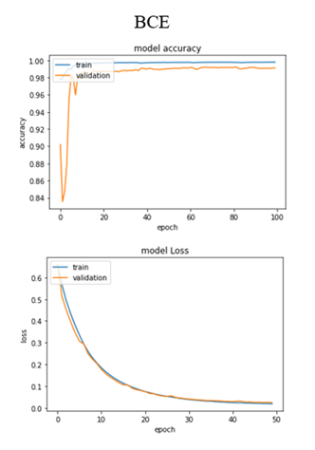
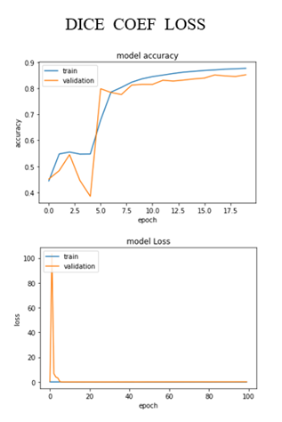
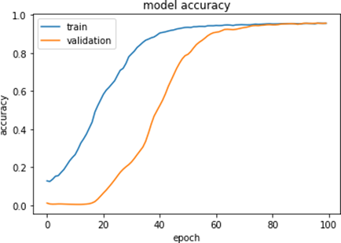
Brain Segmentation Dice coeff ,BCE,jaccard loss comparison
Jaccard loss

Slide 14
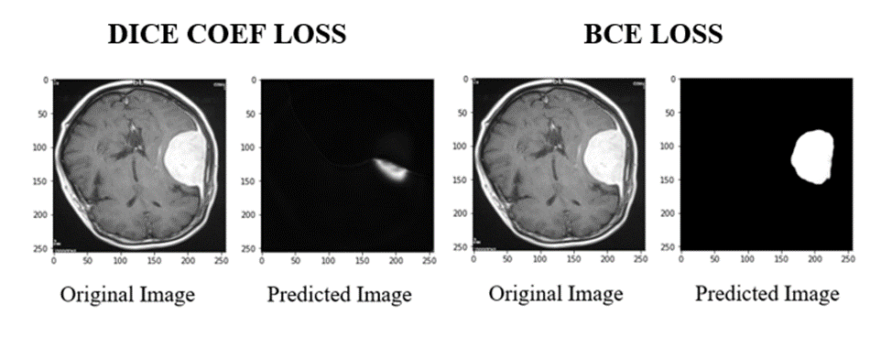
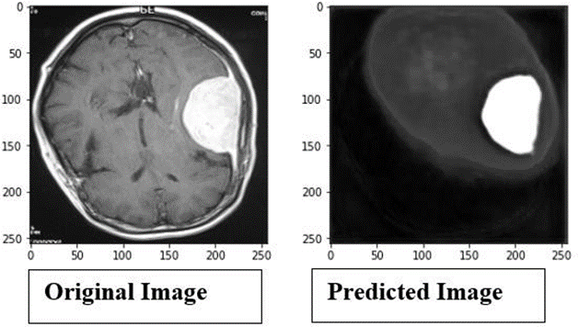
Brain tumour segmentation output
Jaccard loss

Slide 15
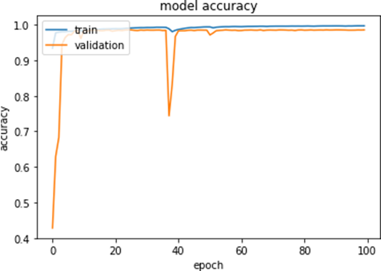
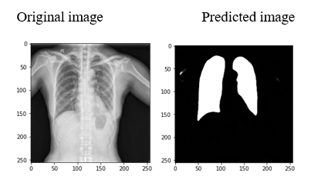
Lung Segmentation BCE Loss

Slide 16
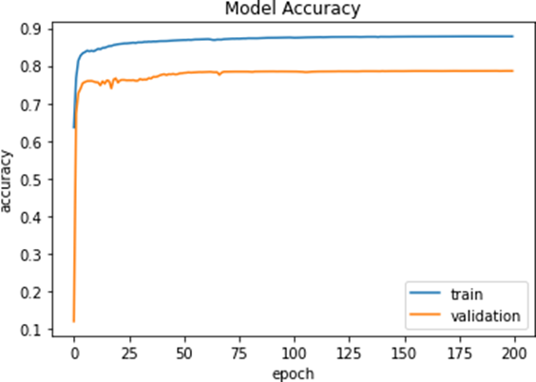
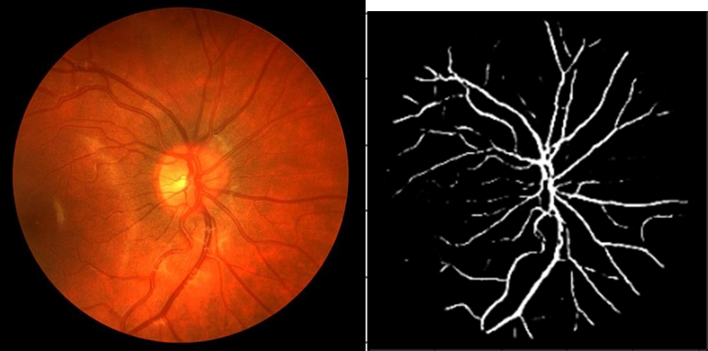
Retina Segmentation BCE Loss

Slide 17
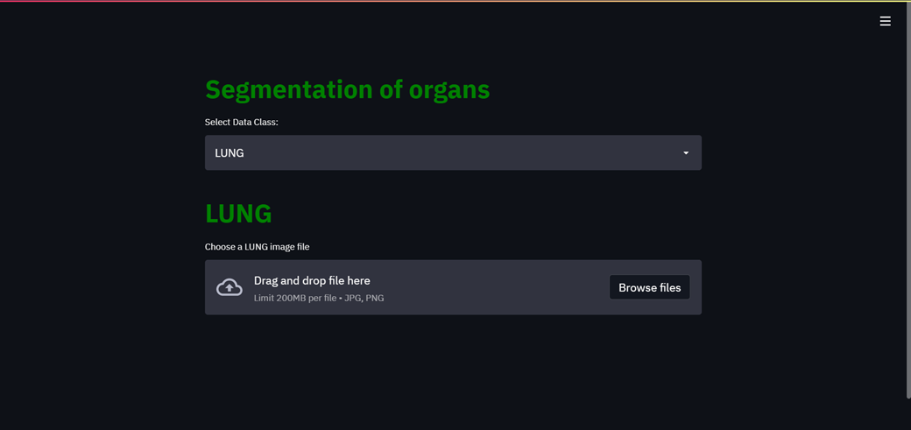
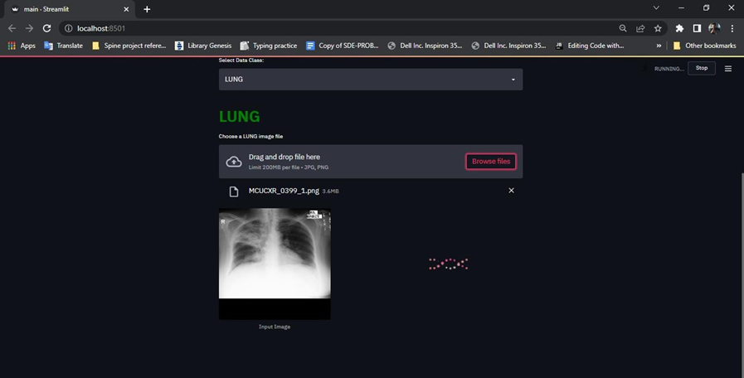
Application ScreenShots

Slide 18
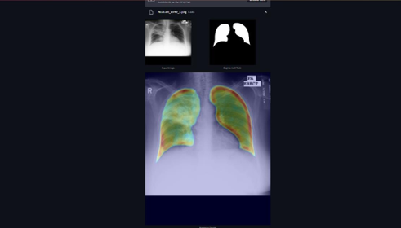
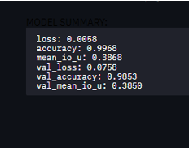

Slide 19
CONCLUSION AND FUTURE ENHANCEMENTS
Conclusion
This project will be useful for the doctor while diagnosing tumors to detect the severity and abnormality with high accuracy. Since the website is integrated with a deep learning model it can be used easily to segment the image feed for the purpose of finding abnormality in human body. The details can be viewed and accessed through a completely intelligent functioning of a dynamic website from time to time. Hence a software website which is developed acts as a complete aid and supportive aspect in the field of healthcare industry for the efficient diagnosis of abnormality in human body.

Slide 20
CONCLUSION AND FUTURE ENHANCEMENTS
Future Enhancements:
Current system focuses mainly on three organs such as brain, lung, and retina. In future current model could be updated and integrated with the website to support segmentation of various.

Slide 21
References:
[1] Rocha, J., Cunha, A. & Mendonça, A.M, J Med Syst “Conventional Filtering Versus U-Net Based Models for Pulmonary Nodule Segmentation In CT Images”, 44, 81 (2020).
[2] Yanming Guo, Yu Liu, Theodoros Georgiou & Michael S. Lew, “Review of Semantic Segmentation using Deep Neura0l Networks”, International Journal of Multimedia Information Retrieval (2018).
[3] Md zahangir Alom, Mahmudul hasan, Chris yakopcic, Tarek M. Taha, vijayan K. Asari, “Recurrent residual convolutional neural network based on U-Net (r2u- net) for medical image segmentation”, (20 feb 2018)
[4] Aashis khanal, Rolando Estrada, “Dynamic deep networks for retinal vessel segmentation”, (19 mar 2019).
[5] S. Minaee, Y. Boykov, F. Porikli, A. Plaza, N. Kehtarnavaz, and D. Terzopoulos, “Image segmentation using deep learning: A survey,” arXiv preprint arXiv:2001.05566, 2020.

Slide 22
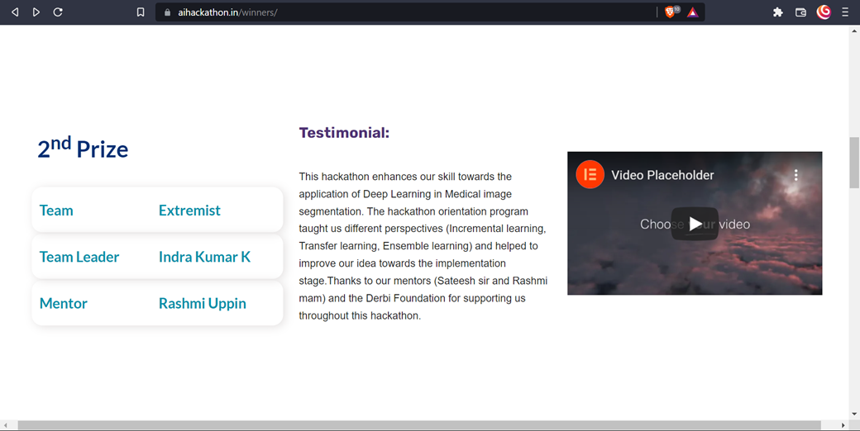
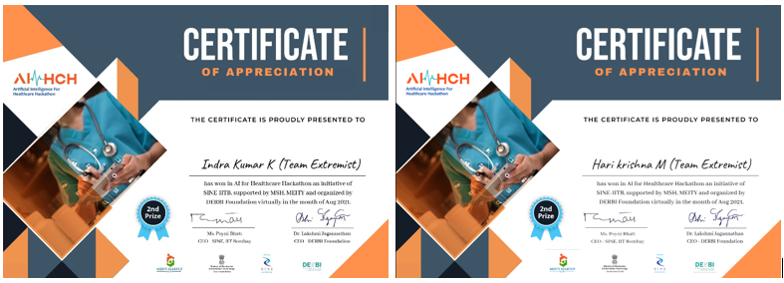
Awards:
This Project Secured SECOND POSITION and won the CASH PRIZE worth of Rs 1,00,000 in AI-HEALTHCARE-HACKATHON an Initiative of SINE – IITB, supported by MSH, MEITY, and organized by the DERBI Foundation.

Slide 23
Thank You !

